Slide 1

Sleep Analysis Based on Deep Belief Networks
NAME
STUDENT ID
SHAOWEI ZHANG
470144491

Slide 2
01
INTRODUCTION
02
SAMPLE SELECTION
03
CLASSIFIER COMPARISON
CONTENTS
04
IMPROVEMENT
05
HMM
06
CONCLUSION

Slide 3
01
INTRODUCTION

Slide 4
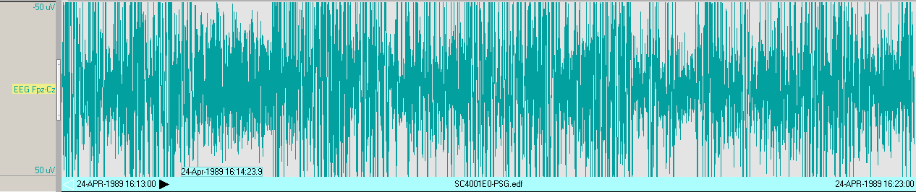
Introduction (Dataset)
EEG Fpz-Cz channel
39 EEGs are used, collected from 20 experiment subjects
Sleep Stage 1
Sleep Stage 2
Sleep Stage 3
Sleep Stage 4
Sleep Stage R
Sleep Stage W

Slide 5
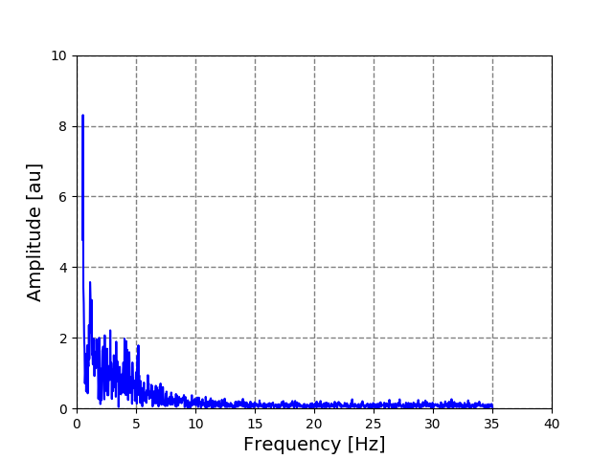
Introduction (Data Processing)
Each epoch is a 30s time series
Using fast Fourier transform (FFT)
Band between 0.5 Hz and 35 Hz will be used

Slide 6
Introduction (Deep Belief Networks)
restricted Boltzmann machine (RBM)
Pre-training
Fine tuning

Slide 7
02
SAMPLE SELECTION

Slide 8
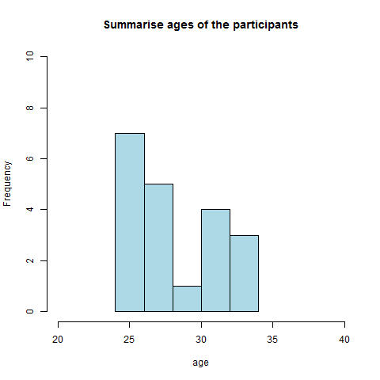
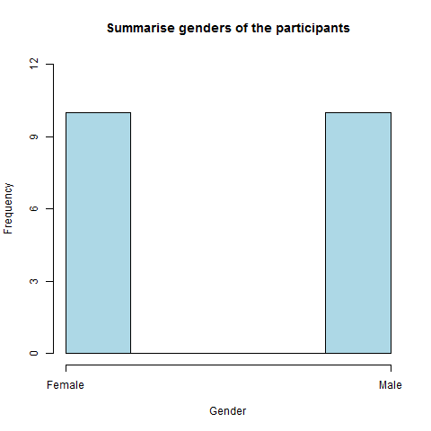
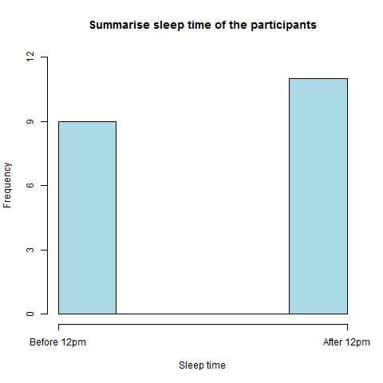
Sample selection (split train and test data)
Two ways:
1. Split all the epochs
2. Use part of the experiment subjects as test data
Drawbacks
Not practical
Not enough experiment subjects

Slide 9
Sample selection (sample ratio selection)
Sleep stage | W | 1 | 2 | 3 | 4 | R | All
Count | 72354 | 2804 | 17799 | 3370 | 2333 | 7717 | 106377
Percentage (%) | 68.02% | 2.64% | 16.73% | 3.17% | 2.19% | 7.25% | 100.00%
Variance = 0.055
Manually control the ratio of each sleep stage.
Use variance as a measurement
 | 1 | 2 | 3 | 4 | 5 | 6 | 7
Way 1 | 0.00262 | 0.00727 | 0.01386 | 0.02674 | 0.03521 | 0.04435 | 0.05710
Way 2 | 0.00152 | 0.00567 | 0.01177 | 0.02423 | 0.03353 | 0.04371 | 0.05704

Slide 10
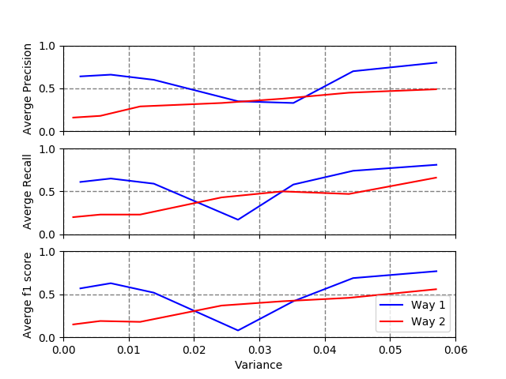
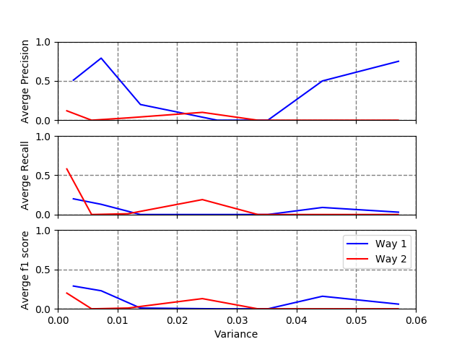
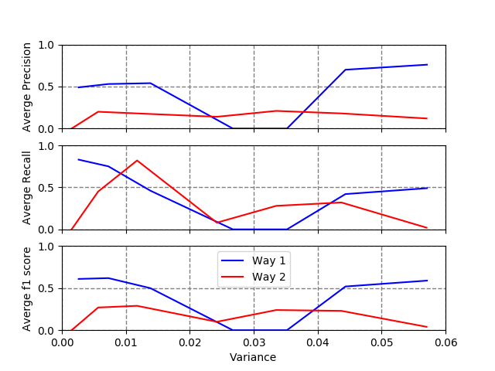
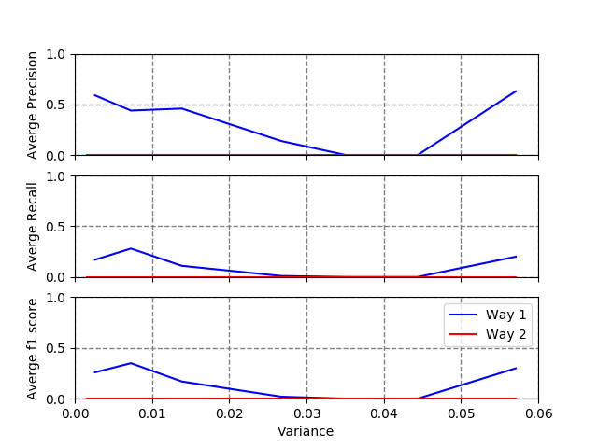
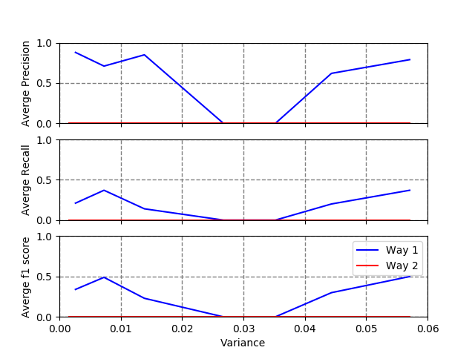
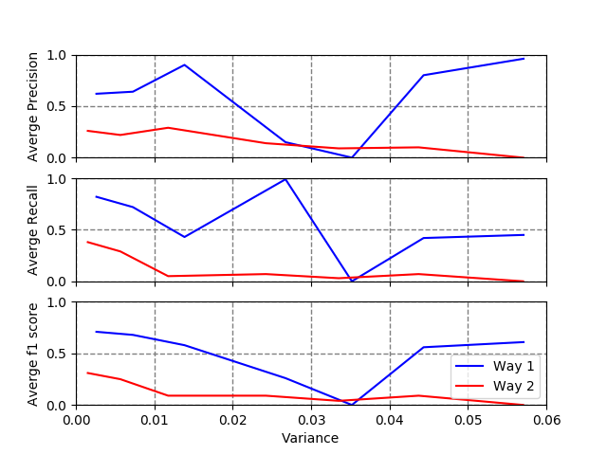
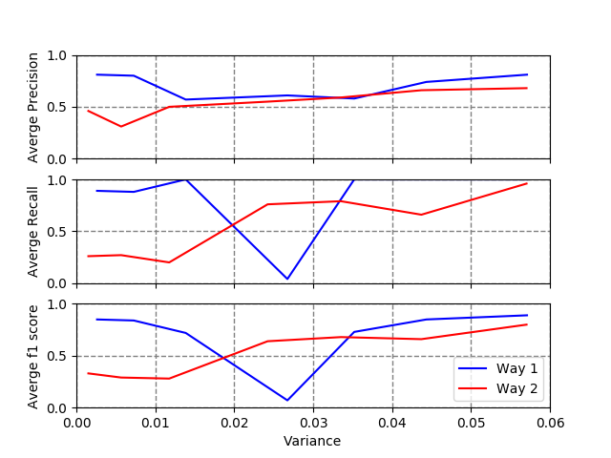
Sample selection
Average
Sleep Stage 1
Sleep Stage 2
Sleep Stage 3
Sleep Stage 4
Sleep Stage R
Sleep Stage W

Slide 11
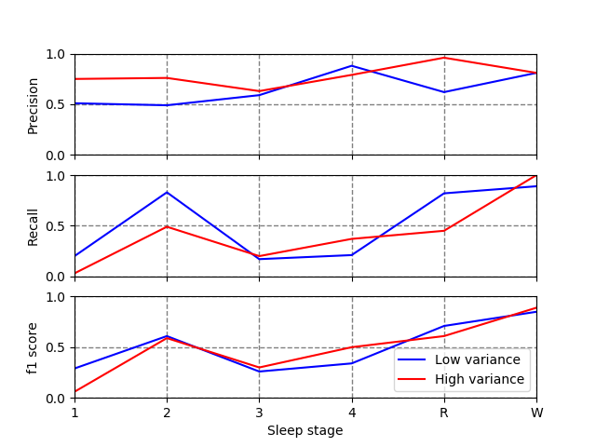
Sample selection
there’s no obvious advantage for any kind because higher precision means lower recall
Low variance:
Steady
High variance:
Sleep stage W extremely good
Sleep stage 1 extremely poor

Slide 12
03
CLASSIFIER COMPARISON

Slide 13
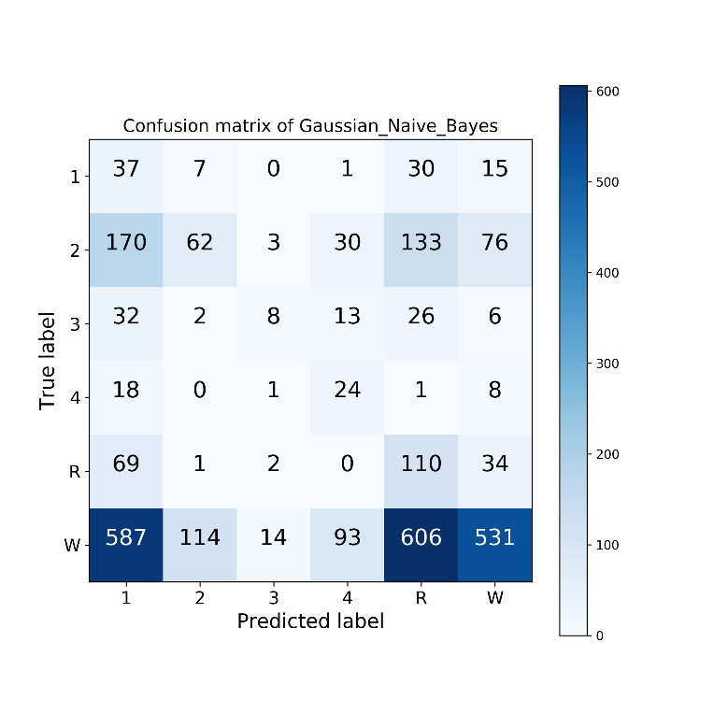
Classifier selection (Gaussian Naïve Bayes)
 | Precision | Recall | f1-score | support
Sleep Stage 1 | 0.04 | 0.41 | 0.07 | 90
Sleep Stage 2 | 0.33 | 0.13 | 0.19 | 474
Sleep Stage 3 | 0.29 | 0.09 | 0.14 | 87
Sleep Stage 4 | 0.15 | 0.46 | 0.23 | 52
Sleep Stage R | 0.12 | 0.51 | 0.2 | 216
Sleep Stage W | 0.79 | 0.27 | 0.41 | 1945
average/total | 0.62 | 0.27 | 0.33 | 2864

Slide 14
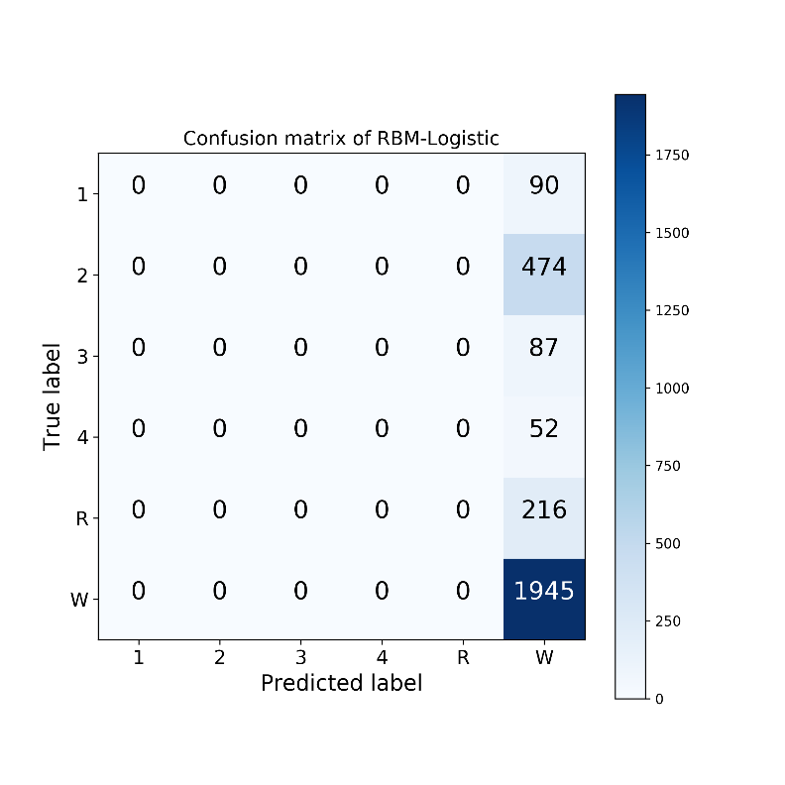
Classifier selection (RBM-Logistic)
 | Precision | Recall | f1-score | support
Sleep Stage 1 | 0 | 0 | 0 | 90
Sleep Stage 2 | 0 | 0 | 0 | 474
Sleep Stage 3 | 0 | 0 | 0 | 87
Sleep Stage 4 | 0 | 0 | 0 | 52
Sleep Stage R | 0 | 0 | 0 | 216
Sleep Stage W | 0.68 | 1 | 0.81 | 1945
average/total | 0.46 | 0.68 | 0.55 | 2864

Slide 15
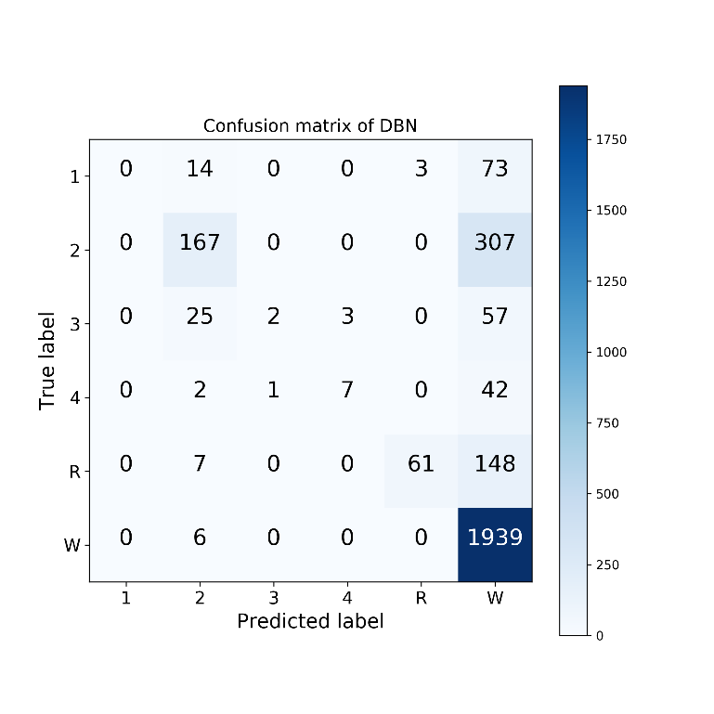
Classifier selection (Deep Belief Networks)
 | Precision | Recall | f1-score | support
Sleep Stage 1 | 0.75 | 0.03 | 0.06 | 90
Sleep Stage 2 | 0.76 | 0.49 | 0.59 | 474
Sleep Stage 3 | 0.63 | 0.2 | 0.30 | 87
Sleep Stage 4 | 0.79 | 0.37 | 0.50 | 52
Sleep Stage R | 0.96 | 0.45 | 0.61 | 216
Sleep Stage W | 0.81 | 1.00 | 0.89 | 1945
average/total | 0.80 | 0.81 | 0.77 | 2864

Slide 16
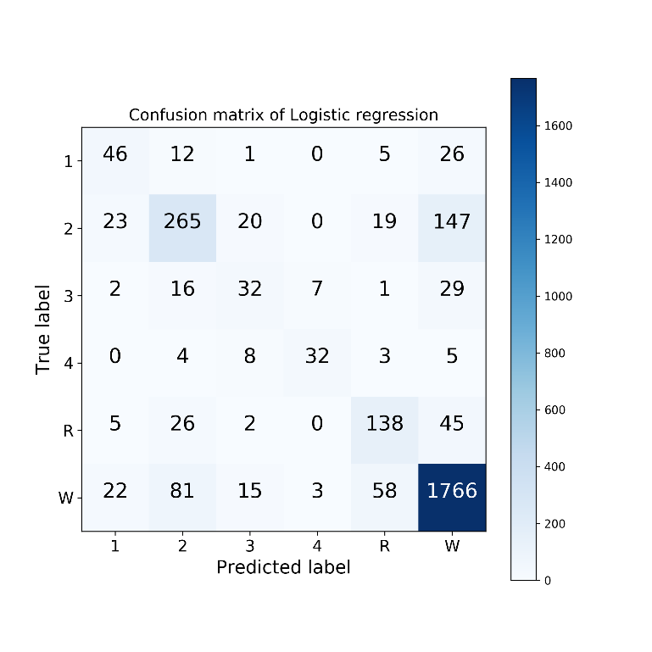
Classifier selection (Logistic Regression)
 | Precision | Recall | f1-score | support
Sleep Stage 1 | 0.47 | 0.52 | 0.50 | 90
Sleep Stage 2 | 0.65 | 0.55 | 0.60 | 474
Sleep Stage 3 | 0.37 | 0.37 | 0.37 | 87
Sleep Stage 4 | 0.76 | 0.62 | 0.68 | 52
Sleep Stage R | 0.59 | 0.63 | 0.61 | 216
Sleep Stage W | 0.88 | 0.90 | 0.89 | 1945
average/total | 0.79 | 0.79 | 0.79 | 2864

Slide 17

Classifier selection (SVM)
 | Precision | Recall | f1-score | support
Sleep Stage 1 | 0.55 | 0.46 | 0.50 | 90
Sleep Stage 2 | 0.59 | 0.68 | 0.63 | 474
Sleep Stage 3 | 0.45 | 0.34 | 0.39 | 87
Sleep Stage 4 | 0.73 | 0.52 | 0.61 | 52
Sleep Stage R | 0.72 | 0.59 | 0.65 | 216
Sleep Stage W | 0.89 | 0.90 | 0.89 | 1945
average/total | 0.80 | 0.80 | 0.80 | 2864

Slide 18
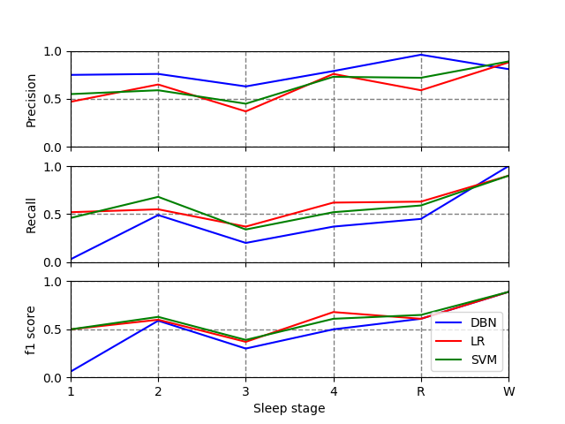
Classifier selection
traditional methods like LR and SVM is slightly better than deep learning methods like DBN.
DBN also has a better performance when classifying sleep stage W, which is quite meaningful.

Slide 19
04
IMPROVEMENT

Slide 20
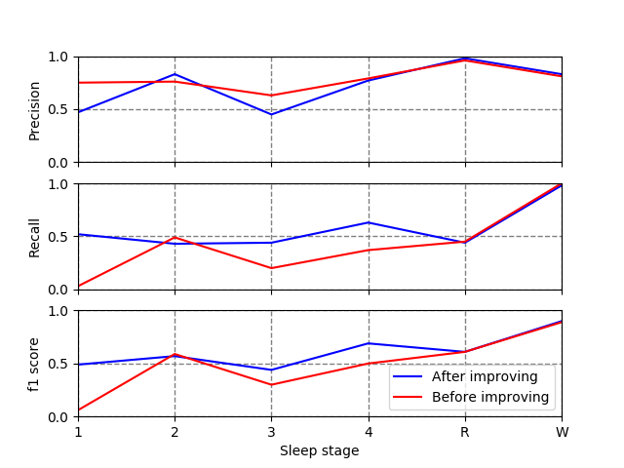
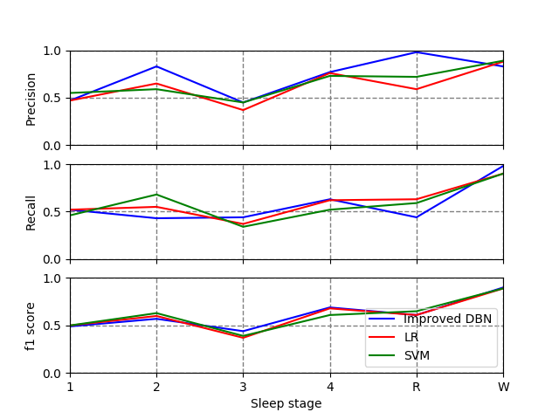
Improvement
DBN has a better performance with Sleep stage 2, R, W
LR has a better performance with Sleep stage 1, 3, 4
Combine DBN and LR to get a improved performance

Slide 21
05
HMM

Slide 22


HMM (Introduction)
{W, W, W, 1, 2, 3, 4, R, W, W}
{W, 1, W, 2, W, 3, W, 4, W, R}

Slide 23
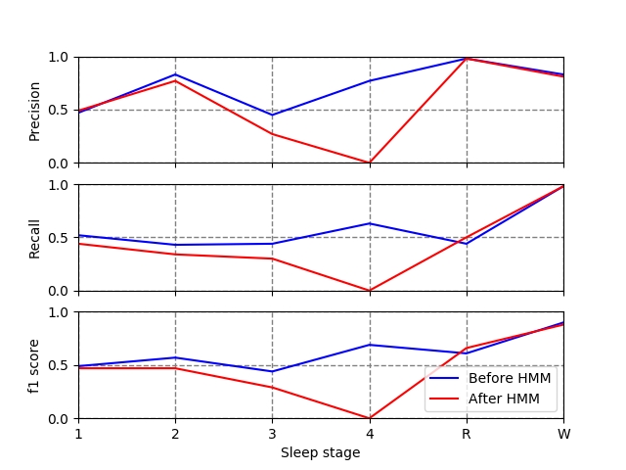
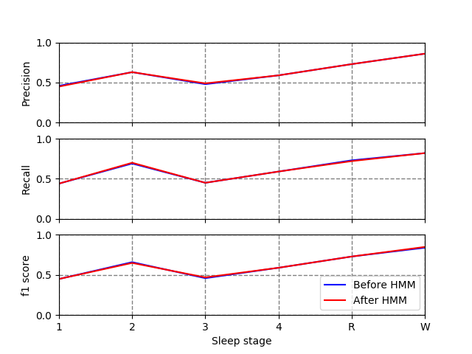
HMM (Result)
High variance
Low variance

Slide 24
06
CONCLUSION

Slide 25
Conclusion
Split train and test data from all the samples
Use samples with high variance
LR and SVM have good performance, but DBN works better to classify sleep stage W
Combine DBN with LR to improve the performance
HMM is not recommended

Slide 26
Thank you !

